Slide 1

HR Analytics Dashboard Predict attrition of your valuable employees

Slide 2
Business problem
HR Analytics Employee Attrition & Performance
(Predict attrition of your valuable employees)
The Business problem is about to find the factors which affect the attrition rate and on which factor we have to concentrate so we can able to predict the attrition of employees and try to reduce it.
In our data source there are 1470 rows but we reduce it to 1000 rows and make our analysis on it.

Slide 3
Description
Employees are the backbone of any organization. Its performance is heavily based on the quality of the employees and retaining them. With employee attrition, organizations are faced with a number of challenges:
Expensive in terms of both money and time to train new employees
Loss of experienced employees
Impact on productivity
Impact on profit
The following solution is designed to help address the employee attrition problem.
The dataset contains HR analytics data of employees that stay and leave. The types of data include metrics such as education level, job satisfactions, and commute distance.

Slide 4
THE DATA
It contains employee attrition(a gradual reduction in work force without firing of personnel, as when workers resign or retire and are not replaced) data.Data-Set consist of both Active and Inactive Employee. Attrition tells the status of employee and where attrition is yes means those who leave organisation what is the state of them means their Monty income, their life Balance before they leave the organisation
(Data source: https://www.kaggle.com/pavansubhasht/ibm-hr-analytics-attrition-dataset.)
IBM has gathered information on employee satisfaction, income, seniority and some demographics. It includes the data of 1470 employees. To use a matrix structure, we changed the model to reflect the following data
NAME | DESCRIPTION
AGE | Numerical Value
ATTRITION | Employee leaving the company (0=no, 1=yes)
BUSINESS TRAVEL | (1=No Travel, 2=Travel Frequently, 3=Tavel Rarely)
DAILY RATE | Numerical Value - Salary Level
DEPARTMENT | (1=HR, 2=R&D, 3=Sales)

Slide 5
DISTANCE FROM HOME | Numerical Value - THE DISTANCE FROM WORK TO HOME
EDUCATION | Numerical Value
EDUCATION FIELD | (1=HR, 2=LIFE SCIENCES, 3=MARKETING, 4=MEDICAL SCIENCES, 5=OTHERS, 6= TEHCNICAL)
EMPLOYEE COUNT | Numerical Value
EMPLOYEE NUMBER | Numerical Value - EMPLOYEE ID
ENVIROMENT SATISFACTION | Numerical Value - SATISFACTION WITH THE ENVIROMENT
GENDER | (1=FEMALE, 2=MALE)
HOURLY RATE | Numerical Value - HOURLY SALARY
JOB INVOLVEMENT | Numerical Value - JOB INVOLVEMENT
JOB LEVEL | Numerical Value - LEVEL OF JOB
JOB ROLE | (1=HC REP, 2=HR, 3=LAB TECHNICIAN, 4=MANAGER, 5= MANAGING DIRECTOR, 6= REASEARCH DIRECTOR, 7= RESEARCH SCIENTIST, 8=SALES EXECUTIEVE, 9= SALES REPRESENTATIVE)

Slide 6
JOB SATISFACTION | Numerical Value - SATISFACTION WITH THE JOB
MARITAL STATUS | (1=DIVORCED, 2=MARRIED, 3=SINGLE)
MONTHLY INCOME | Numerical Value - MONTHLY SALARY
MONTHY RATE | Numerical Value - MONTHY RATE
NUMCOMPANIES WORKED | Numerical Value - NO. OF COMPANIES WORKED AT
OVER 18 | (1=YES, 2=NO)
OVERTIME | (1=NO, 2=YES)
PERCENT SALARY HIKE | Numerical Value - PERCENTAGE INCREASE IN SALARY
PERFORMANCE RATING | Numerical Value - ERFORMANCE RATING
RELATIONS SATISFACTION | Numerical Value - RELATIONS SATISFACTION
STANDARD HOURS | Numerical Value - STANDARD HOURS
STOCK OPTIONS LEVEL | Numerical Value - STOCK OPTIONS
TOTAL WORKING YEARS | Numerical Value - TOTAL YEARS WORKED
TRAINING TIMES LAST YEAR | Numerical Value - HOURS SPENT TRAINING

Slide 7
WORK LIFE BALANCE | Numerical Value - TIME SPENT BEWTWEEN WORK AND OUTSIDE
YEARS AT COMPANY | Numerical Value - TOTAL NUMBER OF YEARS AT THE COMPNAY
YEARS IN CURRENT ROLE | Numerical Value -YEARS IN CURRENT ROLE
YEARS SINCE LAST PROMOTION | Numerical Value - LAST PROMOTION
YEARS WITH CURRENT MANAGER | Numerical Value - YEARS SPENT WITH CURRENT MANAGER

Slide 8
Description of the columns with numerical values. Create dim tables of these columns.
Education 1 'Below College’ 2 'College' 3 'Bachelor' 4 'Master' 5 'Doctor‘
Job level
1 ‘Senior executives’
2 ‘Executives’
3 ‘Middle management’
4 ‘Advisors’
5 ‘Associate’

Slide 9
JobInvolvement 1 'Low' 2 'Medium' 3 'High' 4 'Very High'
JobSatisfaction 1 'Low' 2 'Medium' 3 'High' 4 'Very High‘
PerformanceRating 1 'Low' 2 'Good' 3 'Excellent' 4 'Outstanding'

Slide 10
RelationshipSatisfaction 1 'Low' 2 'Medium' 3 'High' 4 'Very High'
WorkLifeBalance 1 'Bad' 2 'Good' 3 'Better' 4 'Best'

Slide 11
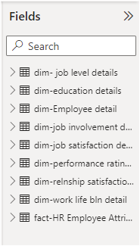
Fact and Dim Tables

Slide 12
Calculate Attrition %
First we create a measure to find the no. of emploees who have “Yes” for the attrition-
Count of Yes =
COUNTROWS(FILTER('fact-HR Employee Attrition','fact-HR Employee Attrition'[Attrition]="Yes"))
Then I create an another measure to find the no. of total observations
Total obs = COUNTROWS('fact-HR Employee Attrition')
At last , I find the Attrition percent by divining “Countof yes” measure by “Totalobs” measure
Attrition % = [Count of Yes]/[Total obs]*100

Slide 13
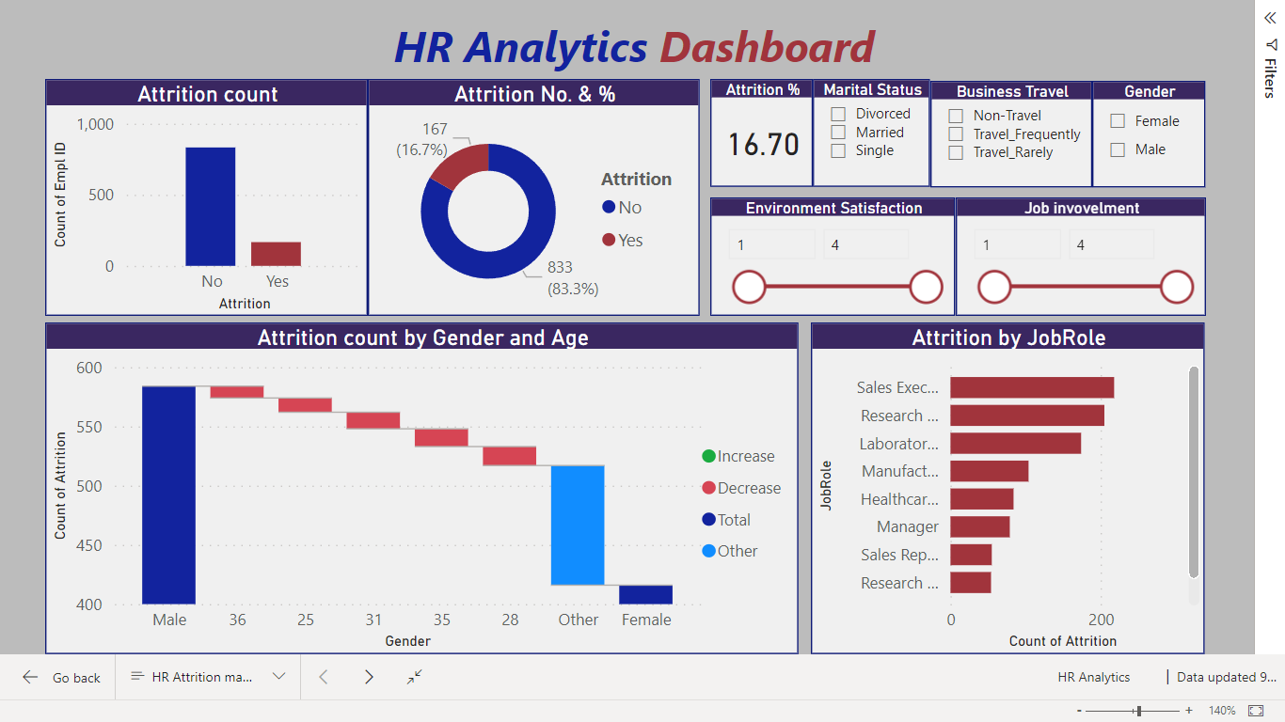
HR Analytics Dashboard

Slide 14
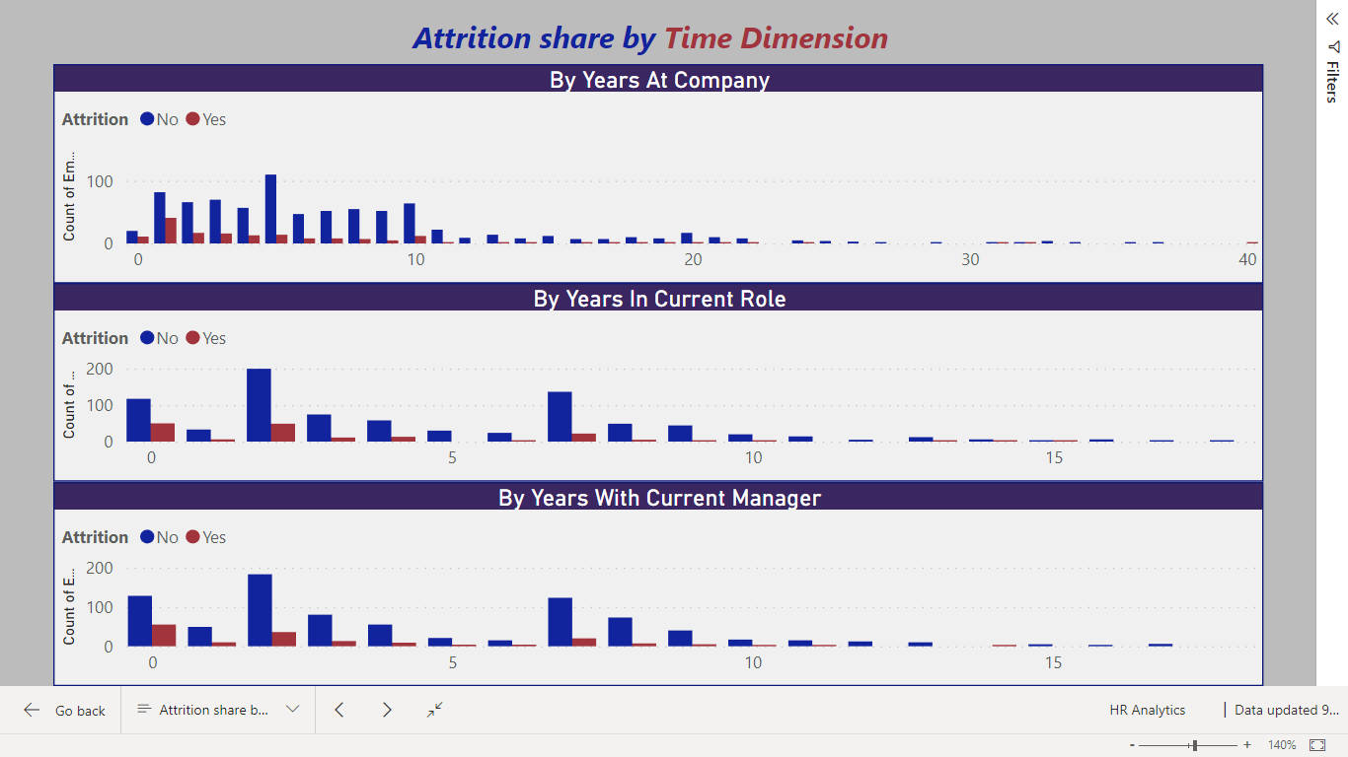
Attrition Share by Time Dimension

Slide 15
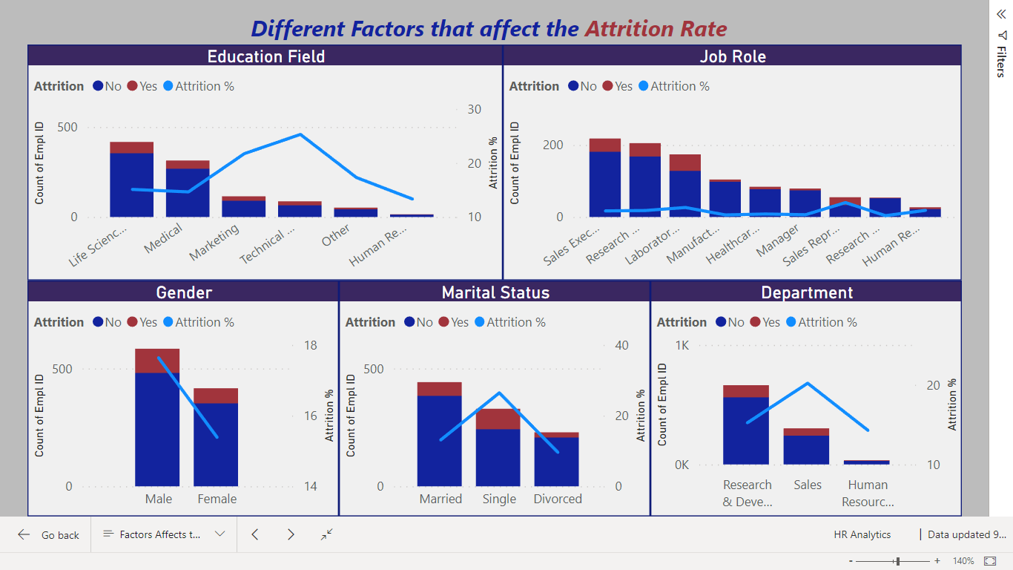
Factors affecting the Attrition Rate(Dashboard)

Slide 16
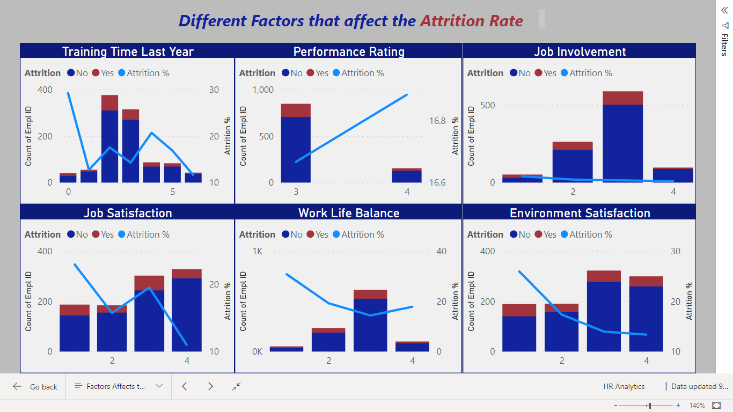

Slide 17
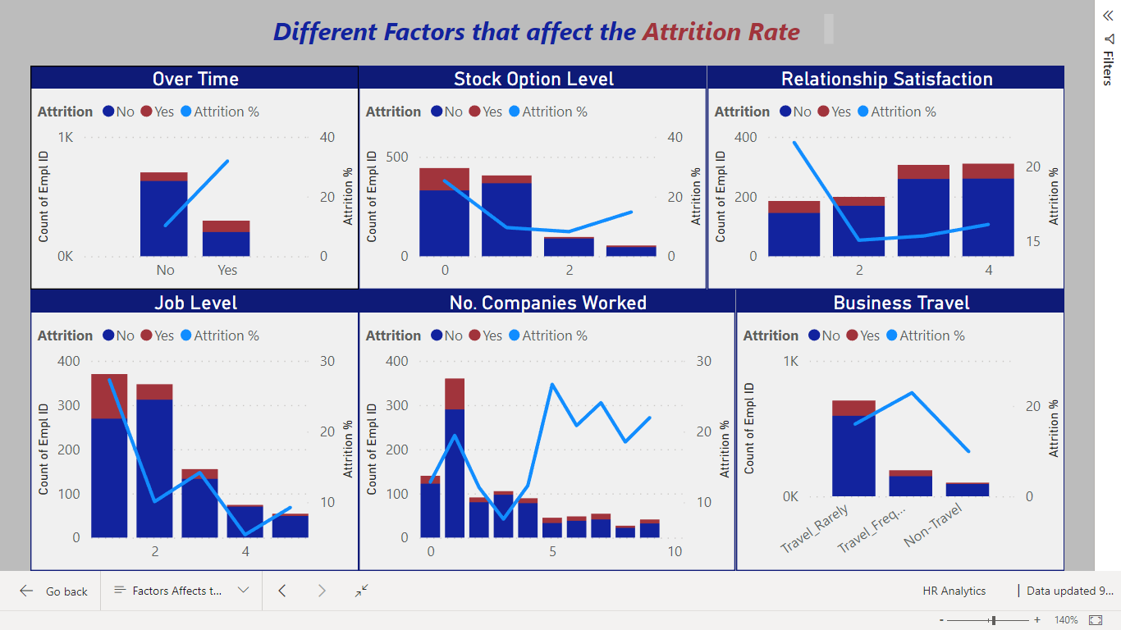

Slide 18
The following main thoughts that emerged from my analysis:
Employees that studied in Marketing and Technical had a higher attrition rate than all the others. (Education Field)
Sales representatives had a tremendously high attrition rate, whilst managers, directors and people in the more senior roles tended to remain in the company’s workforce. (Job Roles)
Attrition was slightly higher for males. (Gender)
A ‘sweet spot’ for employees that were in their second , third or fourth job was noticed. The attrition rate in these cases was remarkably low. (Num of companies work)
Singles were more likely to leave the company than divorced and married employees. (Marital status)
Attrition was slightly high in the Sales department when compared to the R&D and HR departments. (Department)
Employees that were not satisfied in the company, that were very unhappy in their team, that did not have a healthy work life balance, and that were not happy with their work environment were more likely to leave. In all cases we noticed that the attrition rate for ‘very unhappy’ employees was around double than for the other cases. (Job satisfaction and Work Life balance)

Slide 19
There was a preferred stock option scheme, the option number 3. The attrition rate for this scheme was much lower than for the other three. (Stock option level)
Training was also a very important factor. We noticed that the attrition rate for the employees that received no training was around 27%, compared to values that range from 10% to 15% for employees that did receive some training. (Training time)
Higher the Attrition percent when performance rating when rating is given low. As we noticed before, all employees were graded as either 3 or 4. (Performance Rating)
Employees that were not involved in their work tended to leave. (Job involvement)
Overtime had a negative effect on attrition. We noticed that employees were more likely to leave when they did overtime. (Overtime)
A similar situation was encountered when travel was considered. Employees that travelled frequently were more likely to leave. (Business travel)
The employees who are not feeling satistified with environment and also with relations with each other employees are also have higher attrition . (Environment satisfied and Relationship satisfaction)

